Slide 1
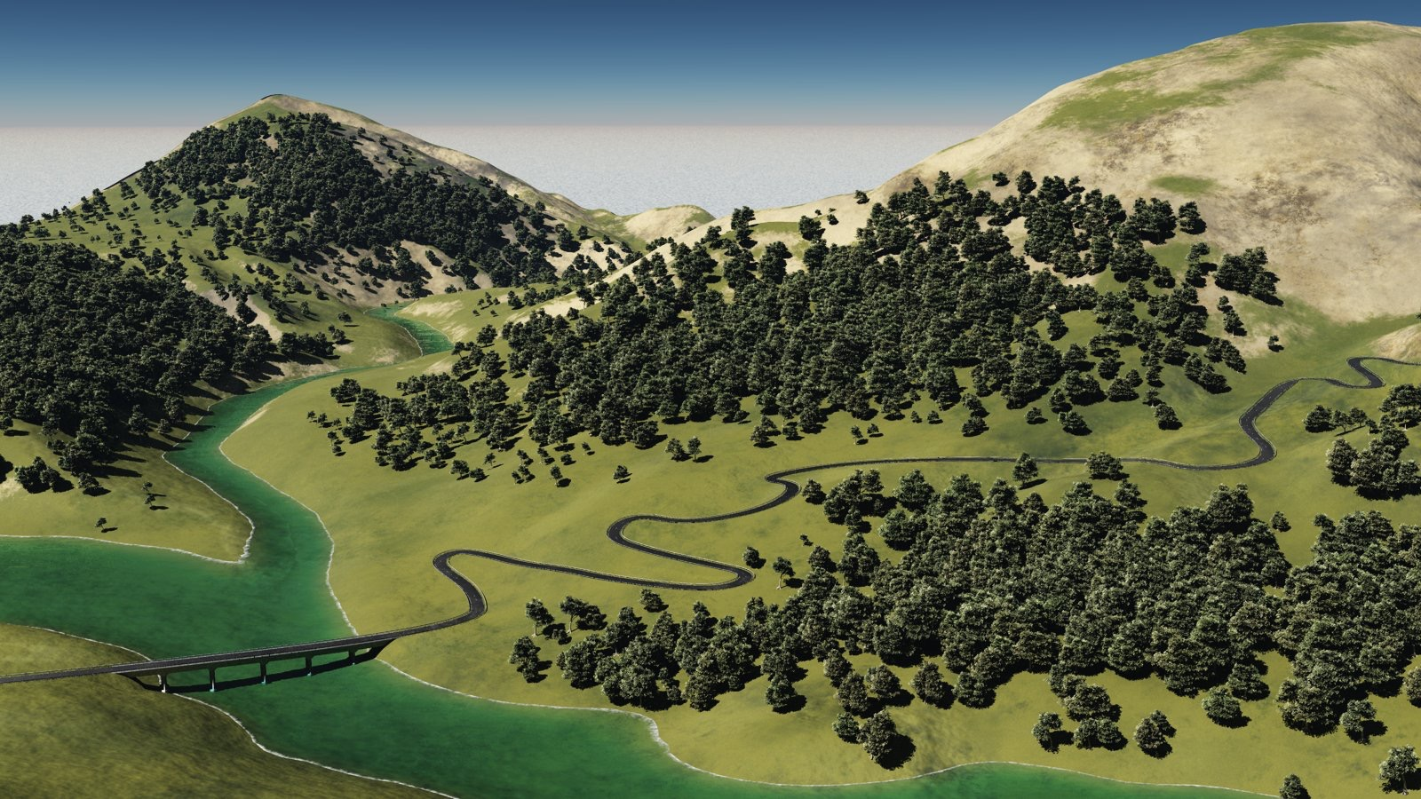
Procedural Generation of Mountain Ranges based on Geology
Initial presentation
Presented by: Bernhard Fritz
Supervisor: Univ.-Prof. Dr. Matthias Harders
Group: Interactive Graphics and Simulation

Slide 2
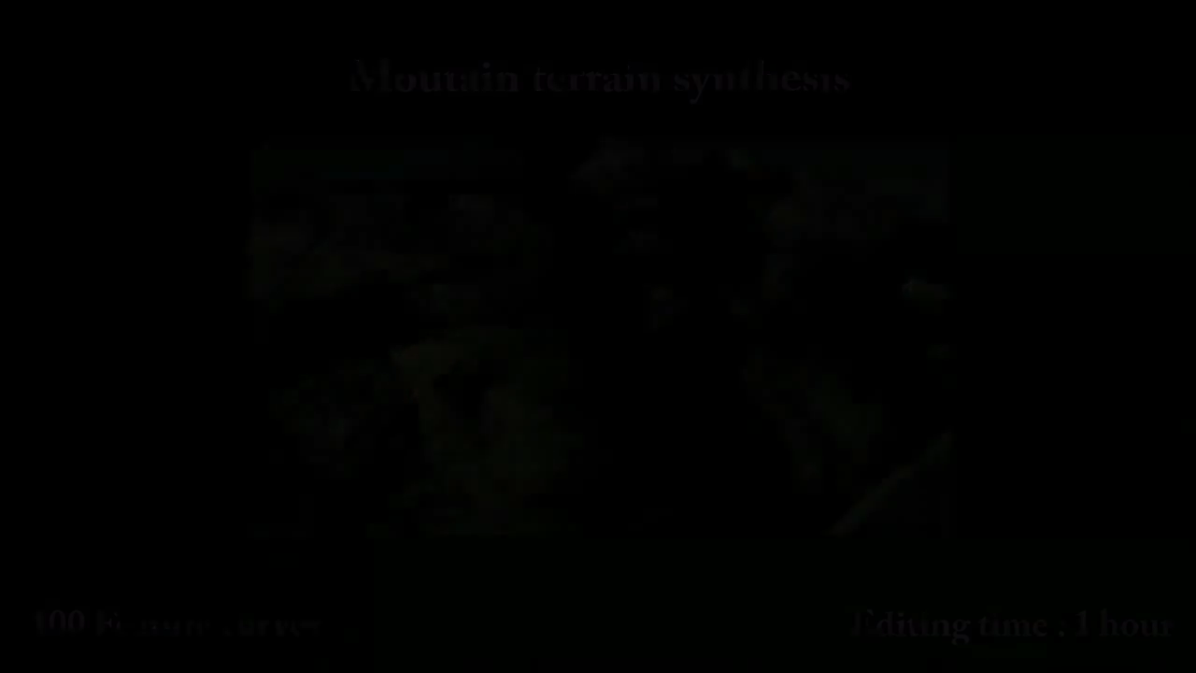
Motivational video
[Liris Group]

Slide 3
Task description
Implement and test various terrain generating algorithms
Develop an algorithm to generate mountain ranges
Learn about how mountains originally came into existence on Earth
Extend the algorithm based on geology

Slide 4
Methods for generating mountains
Generation of heightmaps to encode elevation
Basic terrain generating algorithms
Advanced algorithms based on geology

Slide 5
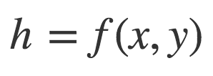

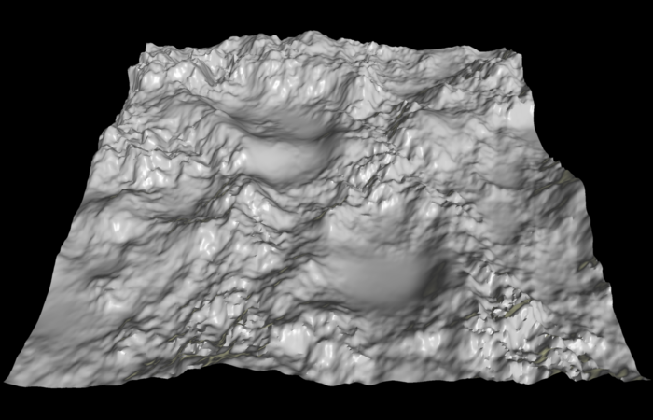
Generating mountains using heightmaps
Grayscale image containing height data
1 byte per pixel = 256 possible height values
[Kamal, Uddin]

Slide 6
Terrain generating algorithms
Midpoint displacement / Diamond-square algorithm [Fournier et al.]
Fault algorithm [Krten]
Repeated magnification and probing [Kamal, Uddin]

Slide 7
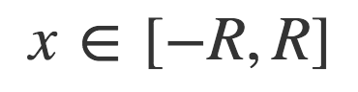

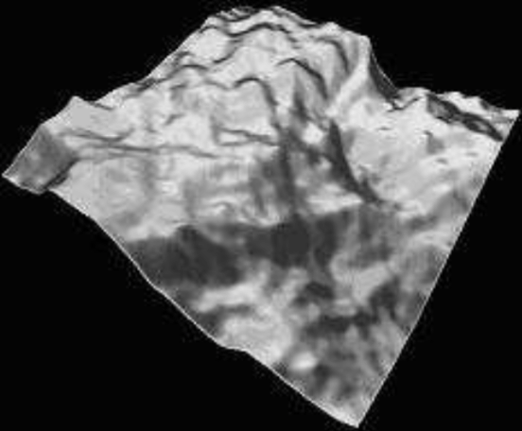
Terrain generating algorithms
Midpoint displacement / Diamond-square algorithm while segments not too small: for each segment: split segment in half raise midpoint by divide R by 2
Fault algorithm
Repeated magnification and probing
[Kamal, Uddin]

Slide 8
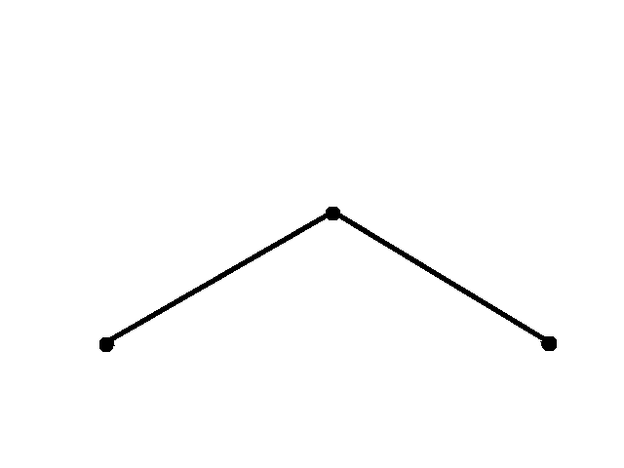
Terrain generating algorithms
Midpoint displacement / Diamond-square algorithm while segments not too small: for each segment: split segment in half raise midpoint by divide R by 2
Fault algorithm
Repeated magnification and probing
[Kamal, Uddin]

Slide 9
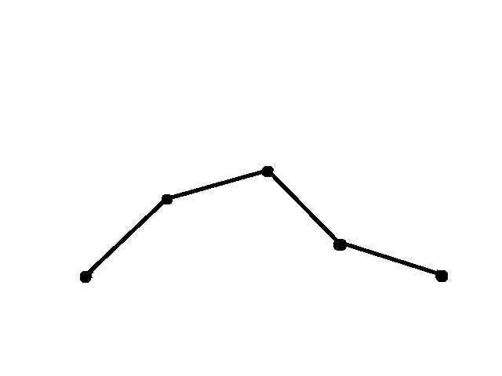
Terrain generating algorithms
Midpoint displacement / Diamond-square algorithm while segments not too small: for each segment: split segment in half raise midpoint by divide R by 2
Fault algorithm
Repeated magnification and probing
[Kamal, Uddin]

Slide 10
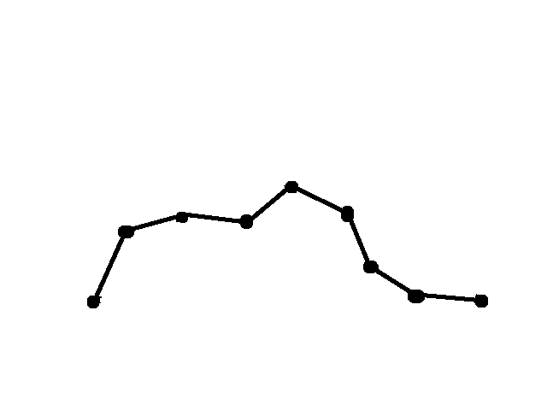
Terrain generating algorithms
Midpoint displacement / Diamond-square algorithm while segments not too small: for each segment: split segment in half raise midpoint by divide R by 2
Fault algorithm
Repeated magnification and probing
[Kamal, Uddin]

Slide 11
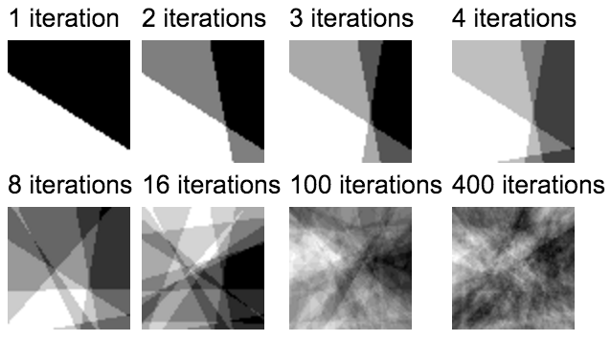
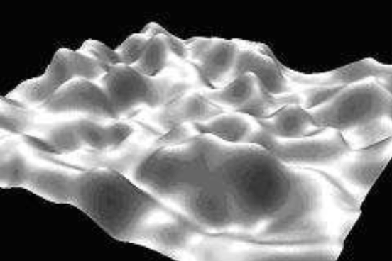
Terrain generating algorithms
Midpoint displacement / Diamond-square algorithm
Fault algorithm
Repeated magnification and probing
[Kamal, Uddin]

Slide 12
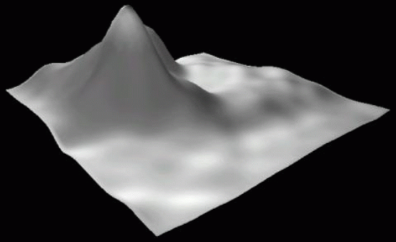
Terrain generating algorithms
Midpoint displacement / Diamond-square algorithm
Fault algorithm
Repeated magnification and probing
Is able to produce a single mountain
Position, altitude and spread can be set by parameters
[Kamal, Uddin]

Slide 13
Algorithms based on geology
Erosion algorithm [Musgrave et al.]
Algorithms considering tectonic plate movement

Slide 14
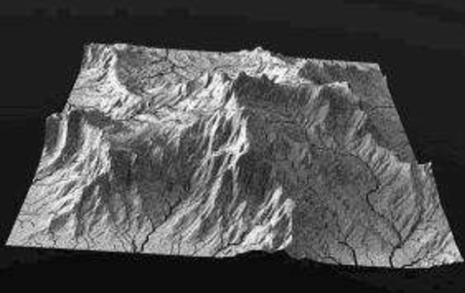
Algorithms based on geology
Erosion algorithm
Simulates the influence of wind and water
Can only be applied to preexisting landscape
Algorithms considering tectonic plate movement
[Kamal, Uddin]

Slide 15
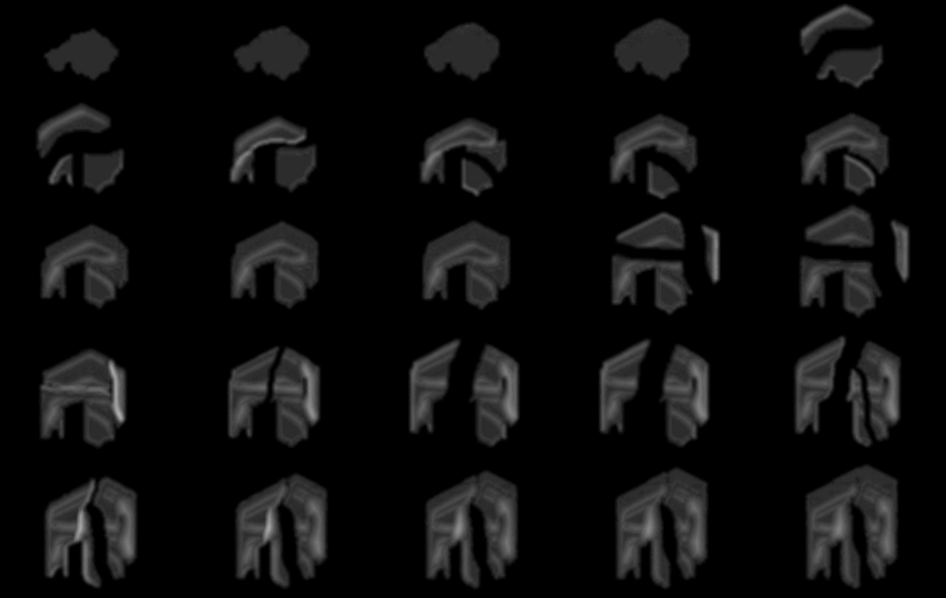
Algorithms based on geology
Erosion algorithm
Algorithms considering tectonic plate movement
Model how tectonic plates react when colliding with each other
[Lauri Viitanen]

Slide 16
Planned schedule
to do | until
Setup programming environment Create data structures Find a visualisation framework | end of december
Implement and test diamond-square as well as fault algorithm | end of january
Extend the RMP algorithm to support generation of whole mountain ranges | end of february
Implement erosion algorithms and combine them with already implemented terrain algorithms | end of march
Implement tectonic plate movement simulation | end of may
Write bachelor thesis | ?

Slide 17
References
K. Raiyan Kamal, Yusuf Sarwar Uddin, “Parametrically controlled terrain generation”, GRAPHITE '07 Proceedings, 17-23, 2007.
Lauri Viitanen, “Physically Based Terrain Generation: Procedural Heightmap Generation Using Plate Tectonics”, 2012.

